Slide 1


Name of Project
Plant Disease Detection with CNN

Slide 2

Understand the role of deep learning in plant disease detection.
Learn how CNNs (Convolutional Neural Networks) help in image classification.
Explore the process of developing and deploying a Streamlit-based web app for disease prediction.
Analyze the impact of automated plant disease detection in agriculture.
Learning Objectives
GOAL
Source :
www.freepik.com/

Slide 3
Tools and Technology used
Programming Language: Python
Libraries: TensorFlow/Keras, OpenCV, NumPy, Pandas, Seaborn
Frameworks: Streamlit for web app deployment
Dataset: Dataset from Kaggle https://www.kaggle.com/datasets/vipoooool/new-plant-diseases-dataset
Hardware: T4 GPU from Collab or Nvidia GPU

Slide 4
Methodology
Data Collection – Images of healthy and diseased plant leaves collected from a dataset.
Preprocessing – Image resizing, normalization, augmentation.
Model Development – CNN architecture designed and trained using TensorFlow/Keras.
Evaluation – Performance metrics like accuracy, precision, recall used.
Deployment – Model integrated with a Streamlit app for real-time disease detection

Slide 5
Problem Statement:
Challenge: Farmers often struggle to identify plant diseases early, leading to reduced crop yield.
Existing Solutions: Manual inspection, which is time-consuming and inaccurate.
Need: An automated, AI-driven solution to detect plant diseases from leaf images.

Slide 6
A CNN-based model trained to classify different plant diseases.
User-friendly Streamlit web app that allows users to upload images and get real-time predictions.
High accuracy and efficiency in disease detection, reducing reliance on expert intervention
Solution:

Slide 7
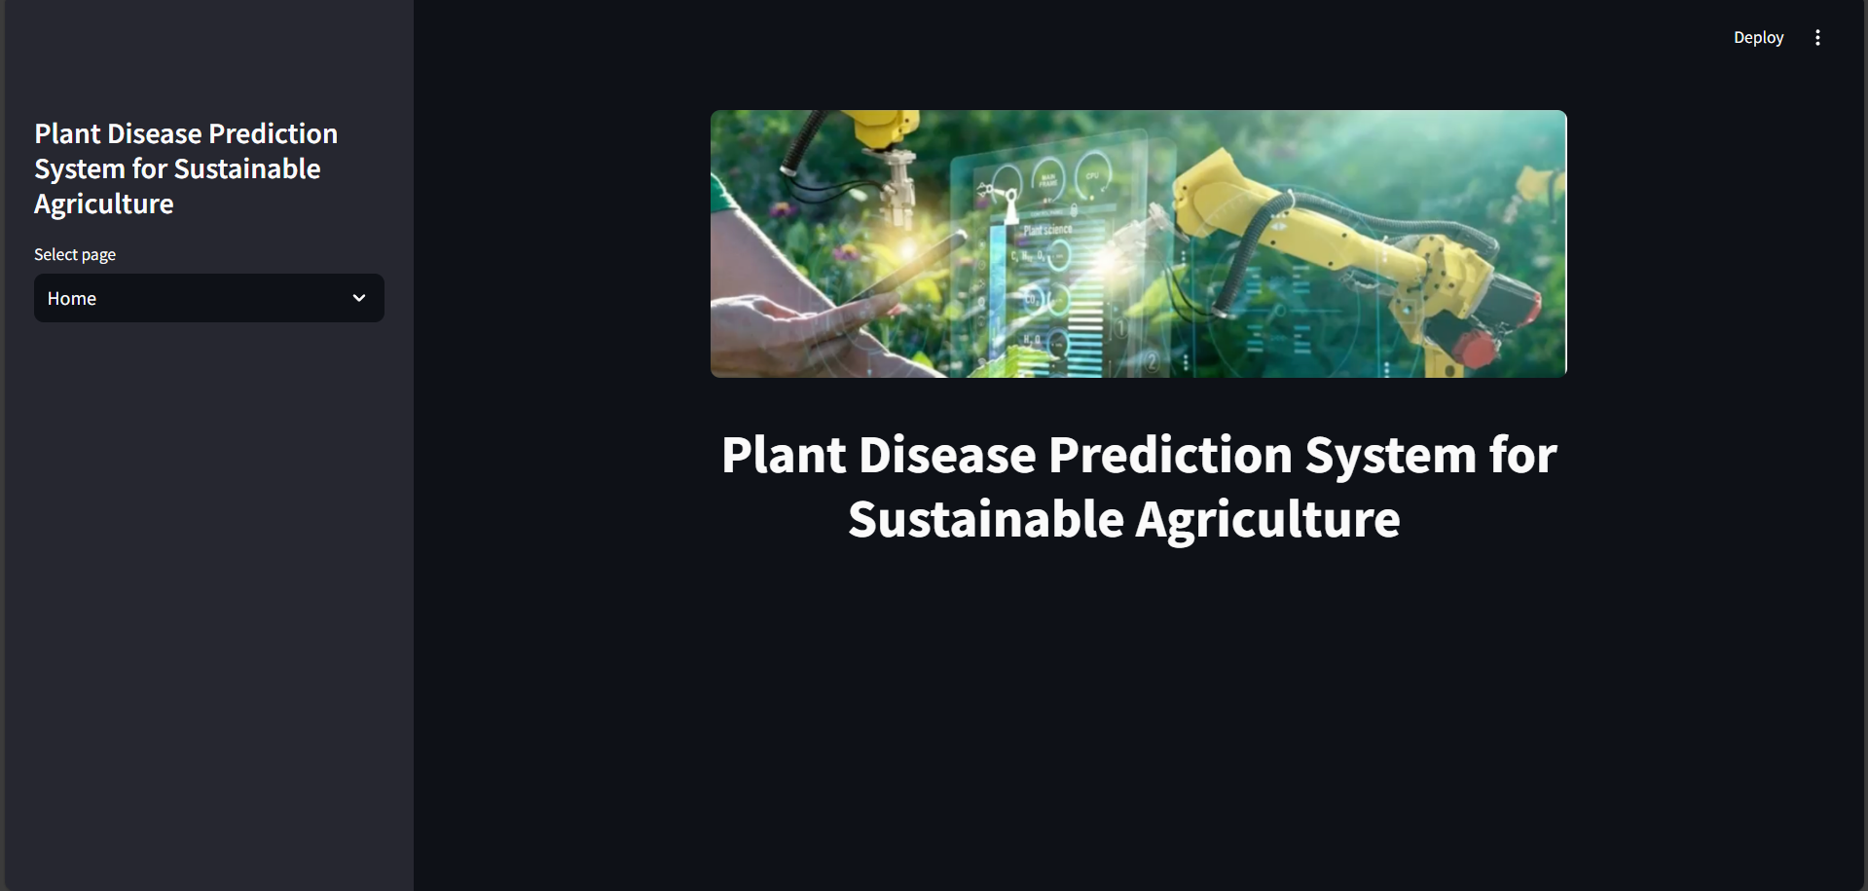
Screenshot of Output:

Slide 8

Screenshot of Output:

Slide 9
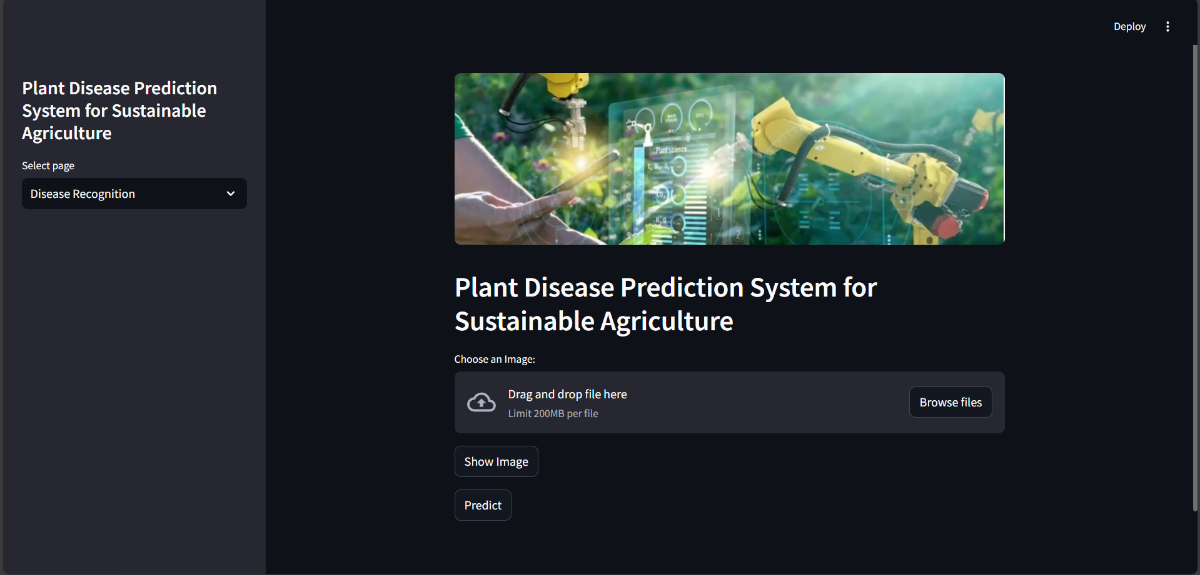
Screenshot of Output:

Slide 10
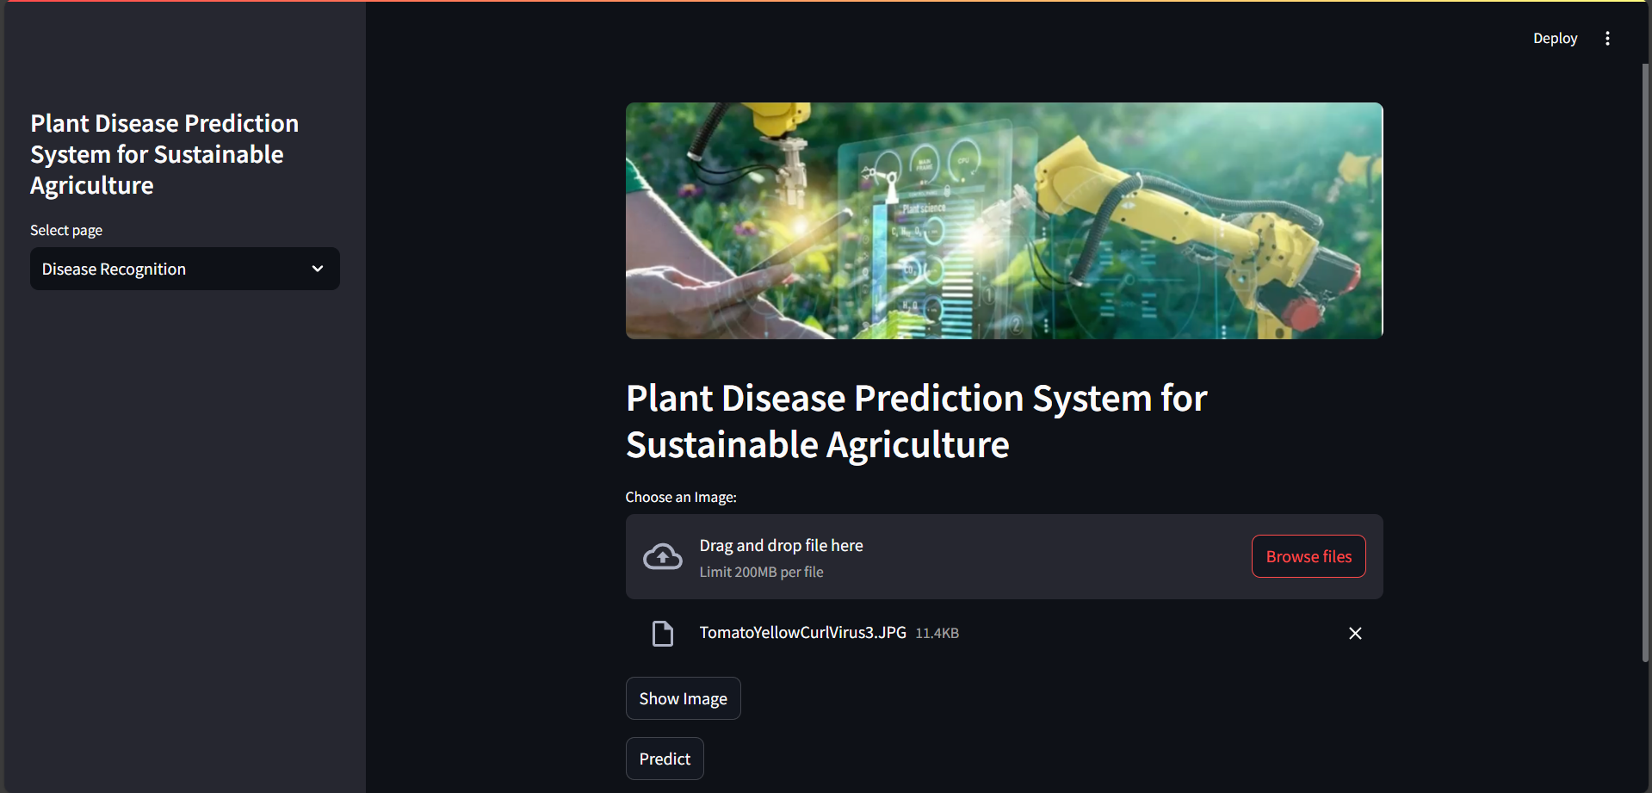
Screenshot of Output:

Slide 11
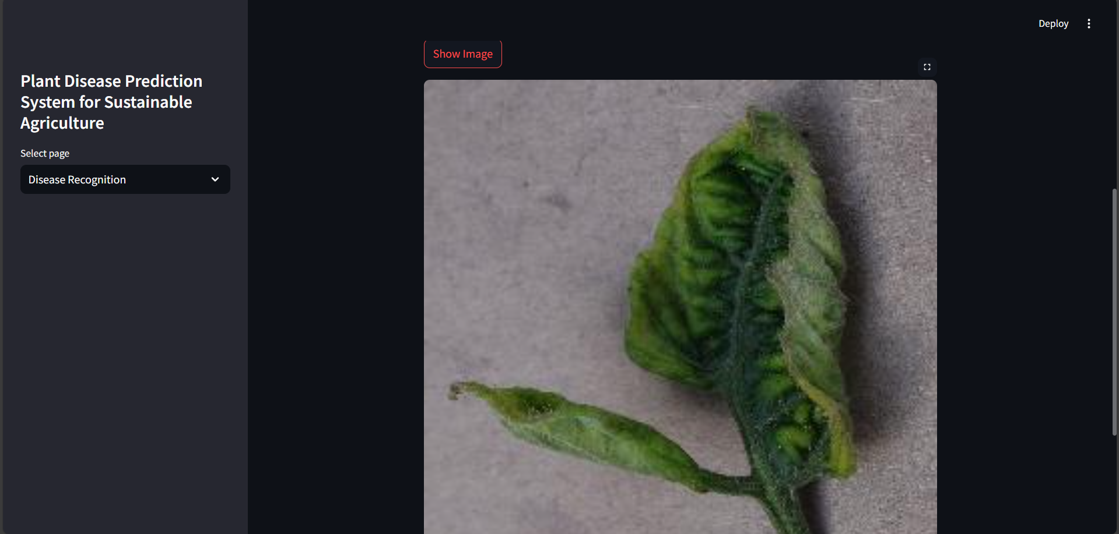
Screenshot of Output:

Slide 12
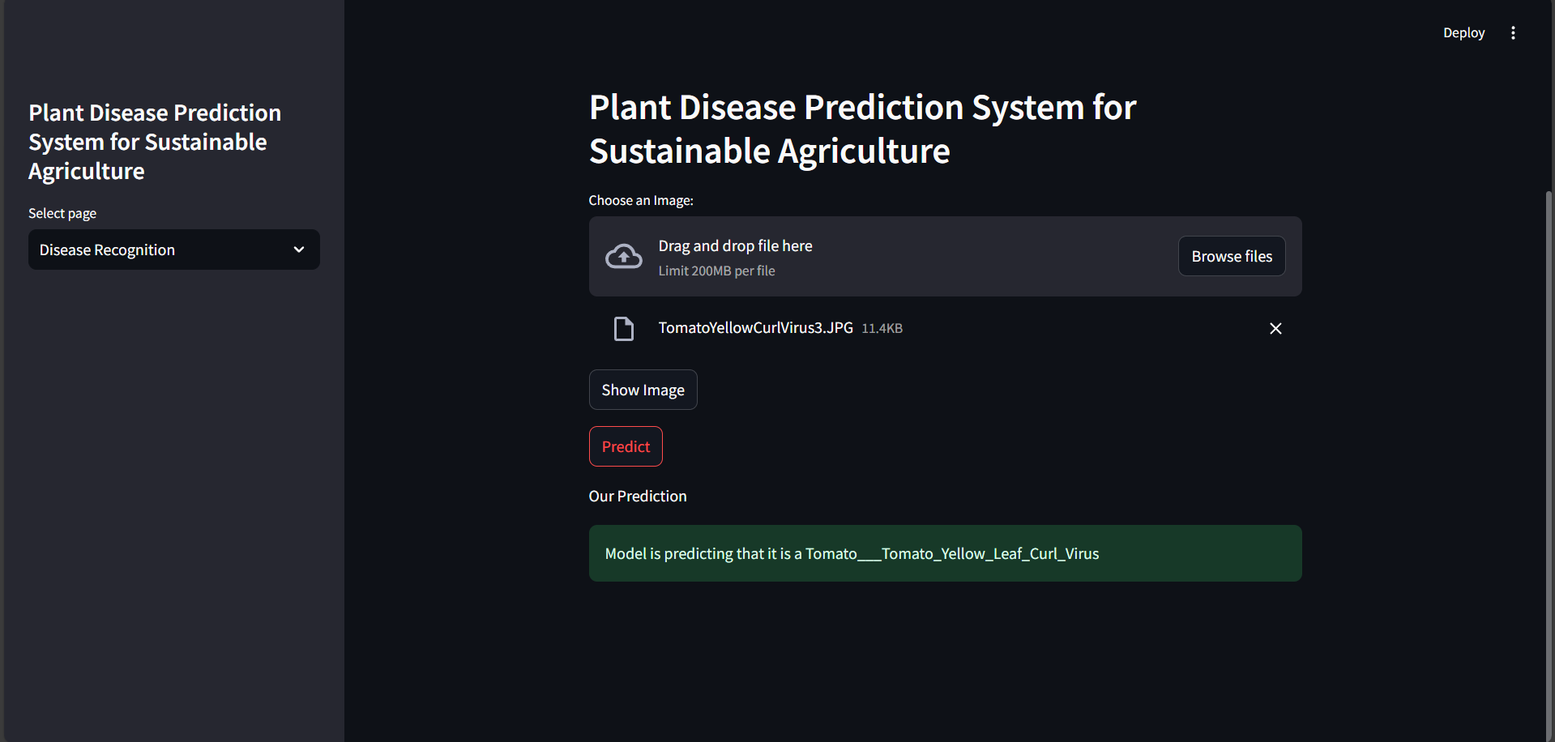
Screenshot of Output:

Slide 13
The project successfully detects plant diseases using CNN.
Automating disease detection can help farmers take timely action.
Future enhancements can include model improvement, more plant species, and cloud deployment.
Conclusion:

